Slide 1
Experiment Mgr Example with Custom Training Loop and UI based on the 3D Brain Segmentation Example
Arnie Berlin, Member of ADAS AD PFT, Novi Office
AE specializing in Computer Vision and Deep Learning
January 3, 2021
Notes:
This is a presentation for a more advanced example of expmgr based on the 3D Brain Example

Slide 2
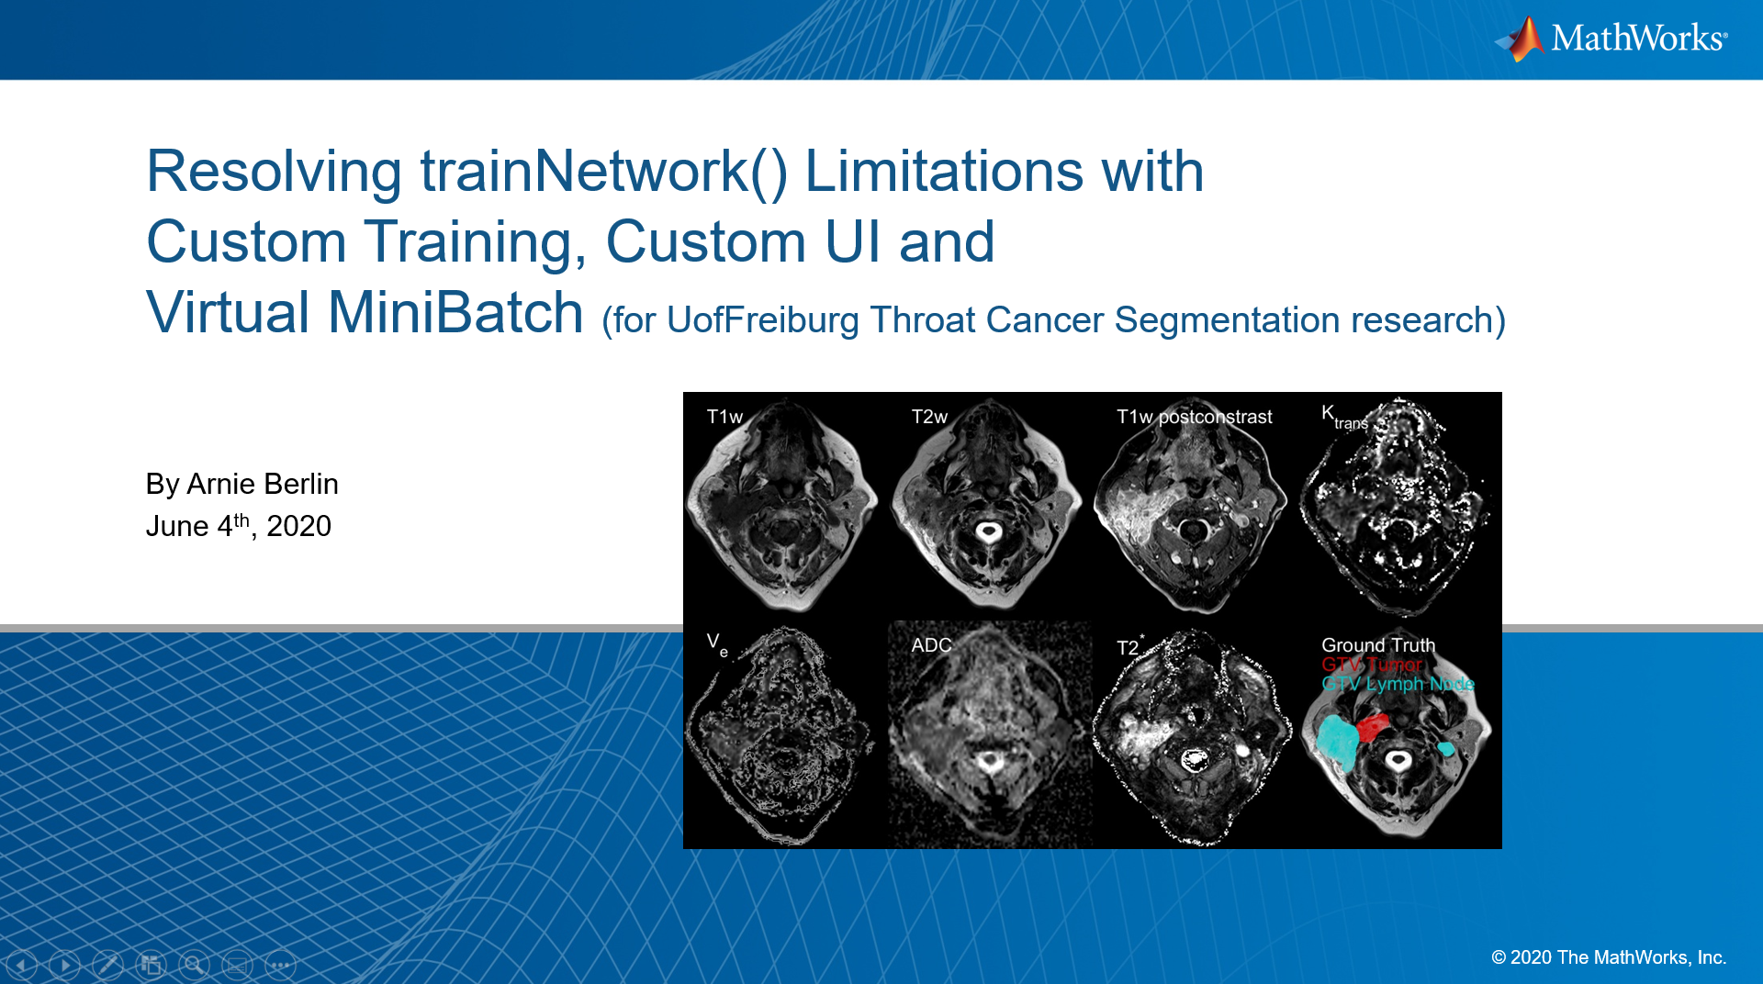
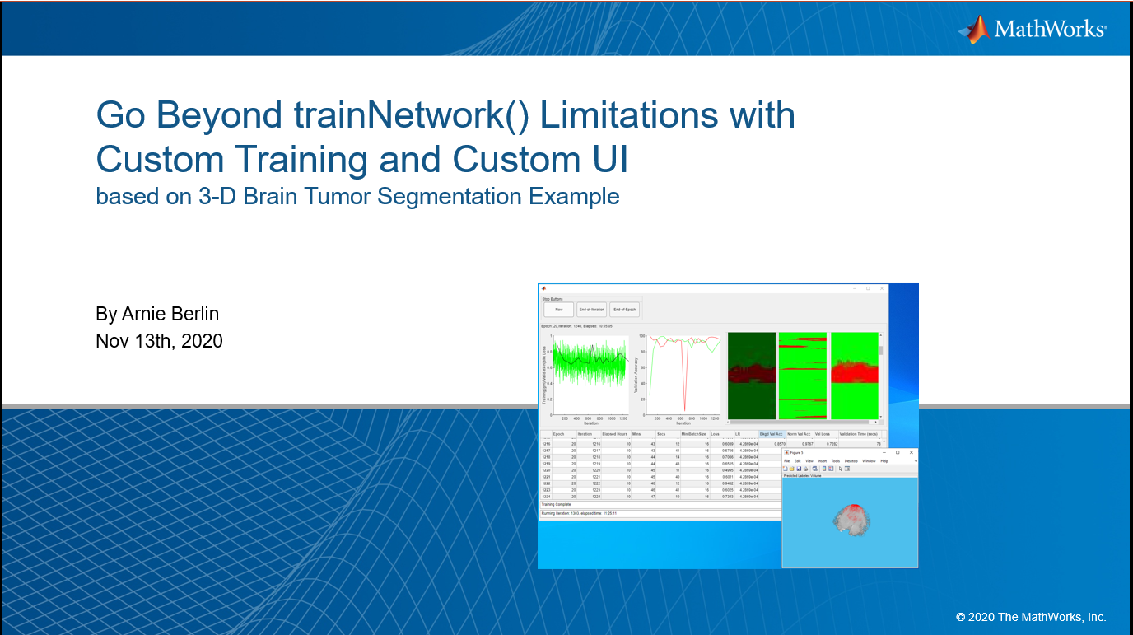

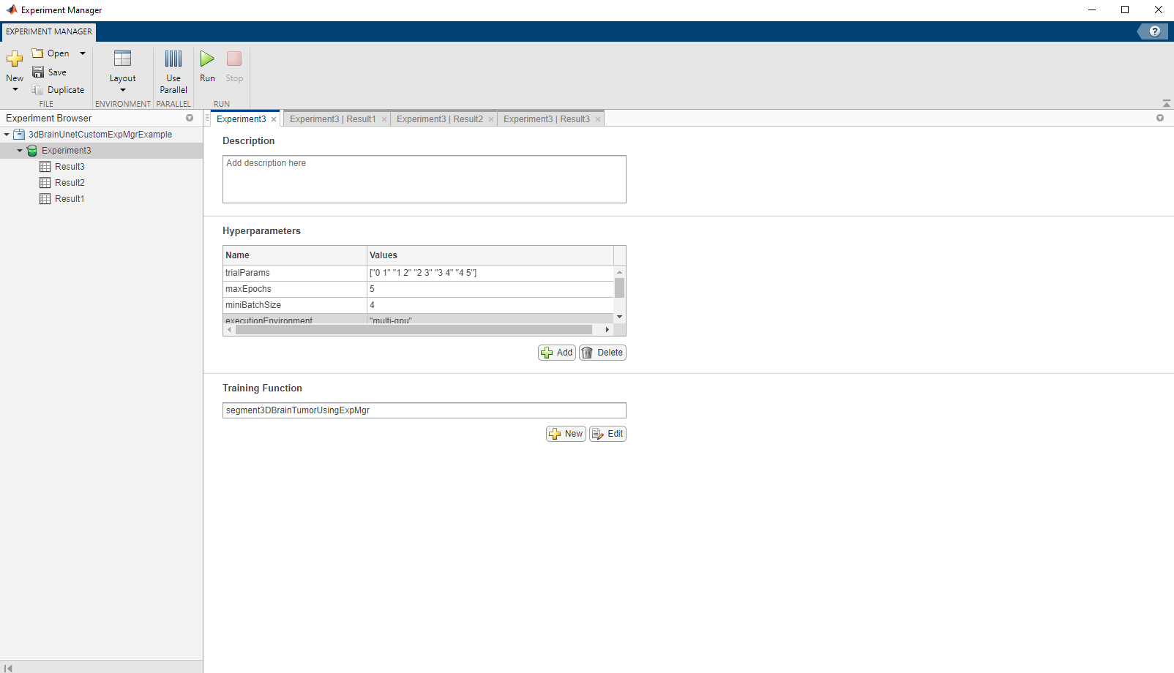
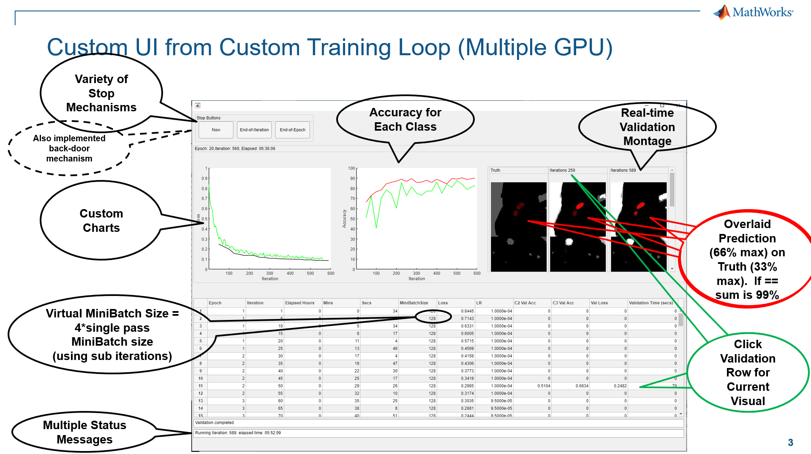
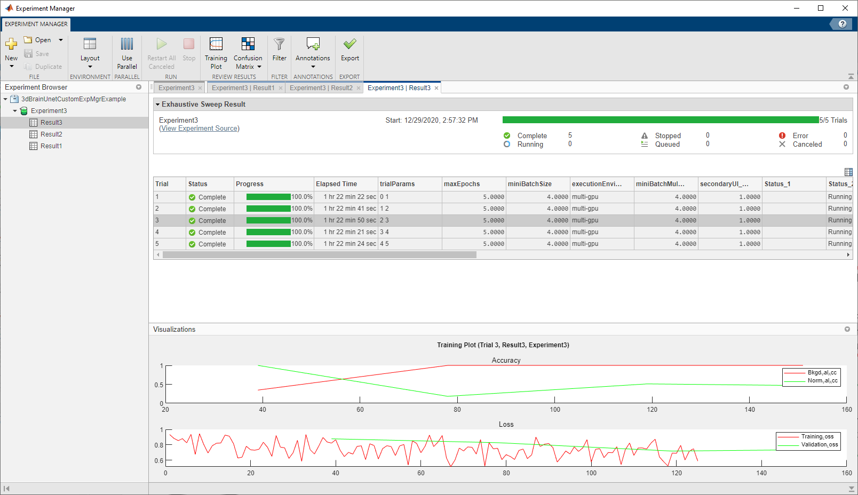
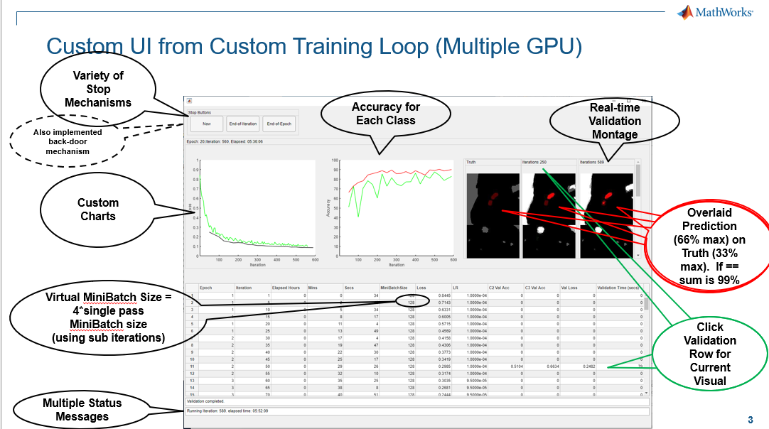
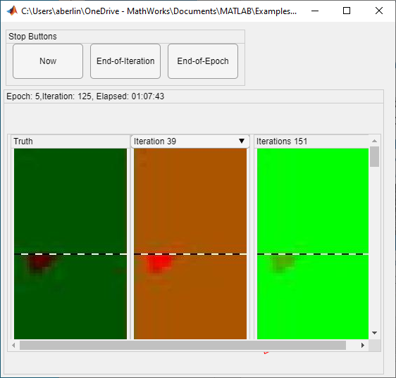
Motivation from Univ of Freiburg Med Res Ctr Project using Multiple MRI Channels
Original solution driven by special needs of customer
Original solution driven by special needs of customer
Ported to 3D Brain example
Ported to 3D Brain example
Ported to R2021a Experiment Manager using Custom Training
Notes:
<laser montage>Motivation for using the expmgr came from a deep engag project I had with the Univ of Frei which involved 3d volumetric data from multiple MRI modalities or channels and required scalability from laptops to the cloud. This montage depicts slices from each modality and the ground truth. We did construct a script using trainNetwork, but we wanted more advanced features <click> and so I developed a version to facilitate them using a custom training loop and taking advantage of parallel constructs. Many of those features are shown by the bubbled notes. One of the primary desired features was the ability plot accuracy per classification instead of the aggregate which would show bias towards dominant classes such as the background. And there were several other advanced features that are too much to discuss here. <click>
I wanted to provide this as an example for all but I couldn’t use the customer’s data so I ported to a version based on our 3D brain segmentation example. <click>
With the advent of R2021a, the expmgr can now support custom loops. I was able to put a wrapper around my work to run it with the expmgr. My estimate is that building the custom UI, which required delving into the details of UI controls, took about a week not including the time to trouble-shoot with time-consuming training iterations. Since the experiment manager had many of those features built-in it only took me a day to port my implementation to it. <next>

Slide 3
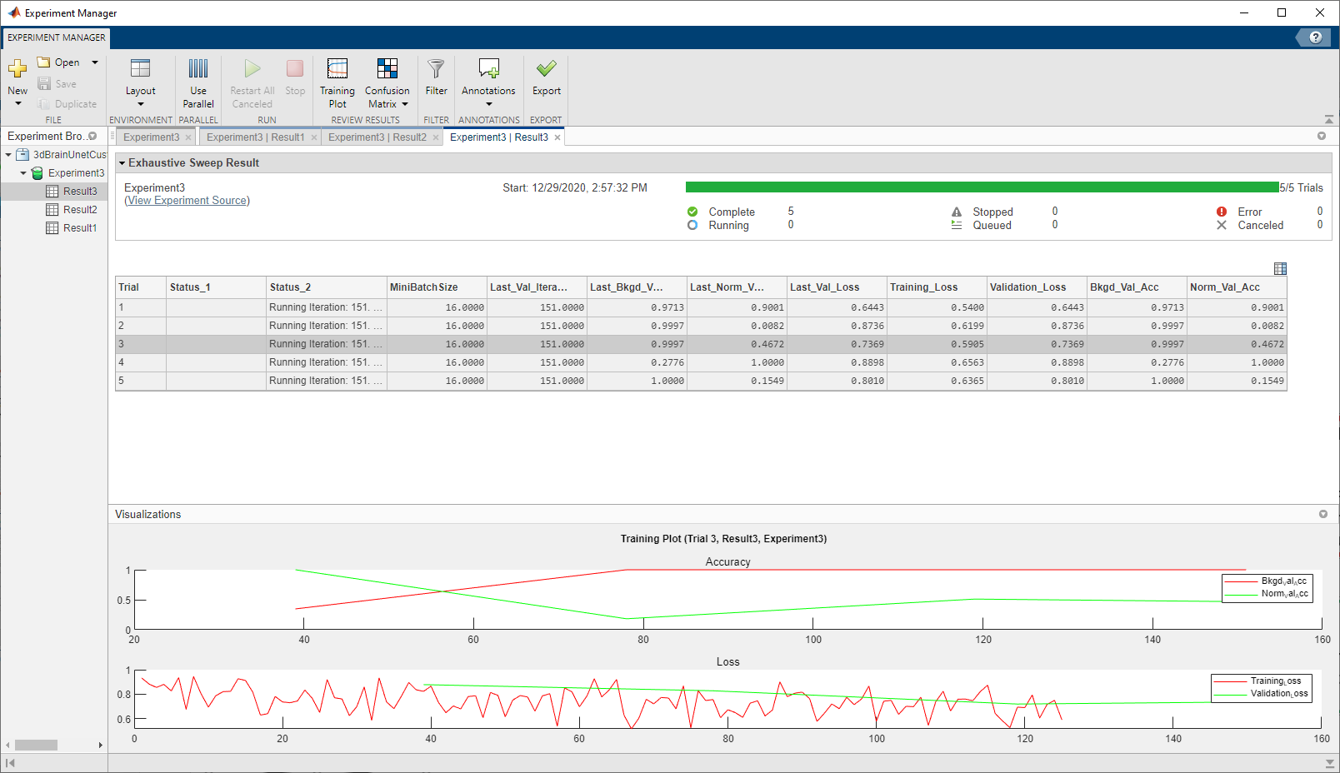
Custom Features Implemented using Experiment Manager
Variety of Stop Mechanisms
Accuracy for Each Class
Select Validation Row for Current Visual
Multiple Status Messages
Secondary UI
Virtual MiniBatch Size = 4*single pass MiniBatch size (using sub iterations)
Overlaid Prediction (66% max) on Truth (33% max). Sum is 99% if equal
Custom Charts
Real-time Validation Montage
Notes:
<laser>Here are some of the features I implemented <click-space bar>…
There is a “stop immediate” and is tied to the stop button in expmgr and “stops” for end of current iteration or epoch.<click>
Validation is facilitated in the background, including ability to visualize predicted image outputs vs groundtruth <click>
As mentioned earlier accuracies for each class from validations and plotting all accuracies in one plot <click>
Extra status messages, beyond the standard ones provided with expmgr. <click>
And, taking advantage of custom loops, the ability to support larger, virtual minibatches. <next>

Slide 4
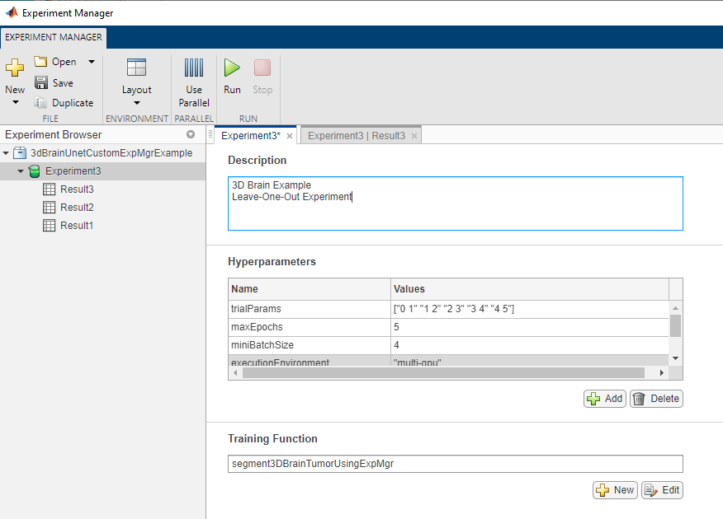
Experiment Setup Panel
String Array to Group Dynamic Parameters per trial
“<channel> <trial num>”
(0=none)
Static parameters for all trials
Notes:
Here is how the trial parameters were facilitated in the expmgr setup panel <click>
A string array was used to specify and group parameters for each trial. <click>
The remainder were single element parameters that would remain static for all the trials, such as maxEpochs and minibatch size. <Next>

Slide 5
Summary
My Custom UI took 1-Week versus 1-Day with Experiment Manager
In addition, I gained the Experiment and Results Management Features
The next step will be to show this to my customer when they have access to R2021a
Notes:
In Summary <click> One key take-away should be that the expmgr is providing faster access to custom metrics and plotting. <click> Another take-away is that the expmgr is providing additional Experiment and Results Management as discussed earlier. <click> The next step will be to show this to my customer when they have access to 2021a. Next Shahed will show another demo where we used custom experiments for Reinforcement Learning

